Slide 1

Bulldogs – Project 1 Presentation
Societal indicators potential impact on life expectancy
Parth korat
Geoff Pawlowski
Ashutosh sawant

Slide 2
Agenda
What are we investigating?
Dataset selection
Data exploration/cleanup
Data analysis
Summary of findings
Discussion of key findings

Slide 3
What are we investigating?
What types of societal indicators may be good predictors of any countries true life expectancy rate?
We found this question to be overly broad
Too many potential indicators to consider
Difficult to extract something useful from something so expansive
Narrowed focus – compare three (3) categories of likely indicators that may correlate with life expectancy and compare across them.
Access to healthcare
Access to basic infrastructure/sanitation services
Access to education
Also identify any interesting findings in the data that could potentially be passed to a national government or non-profit organization who is focused on increasing life-expectancies across a population

Slide 4
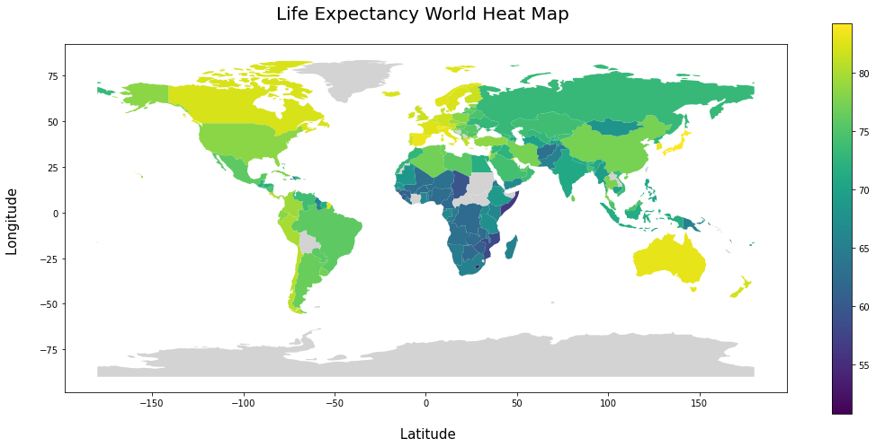

Slide 5
Dataset Selection
10 Datasets
1 Outcome Dataset
9 Societal Indicators

Slide 6
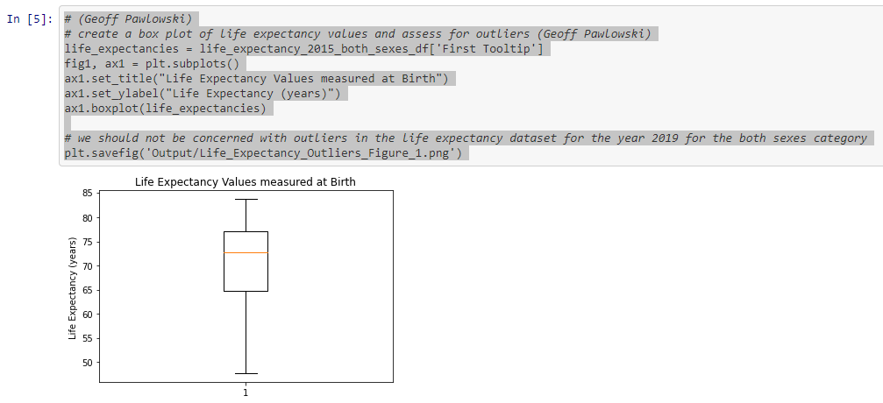
Data Exploration/Cleansing
Text to columns on some of the UN datasets
.rename(columns={……
.columns = [‘xxxxxx’,’bbbbb’,’aaaaa’]
.value_counts()
Outlier Analysis – Boxplots, scatter plots
pd.merge(a, b, on=‘Entity’)
Joined only datapoints that shared common country information, dropped extraneous data

Slide 7
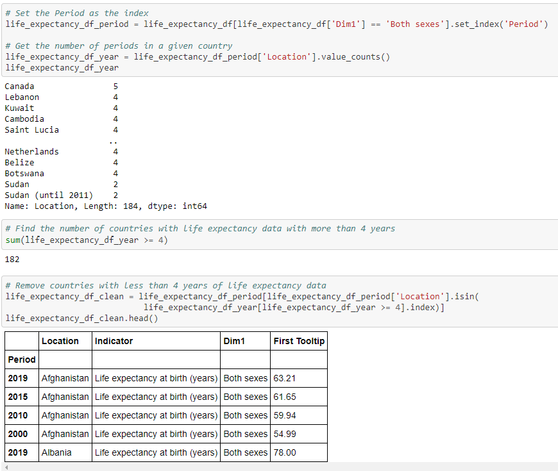
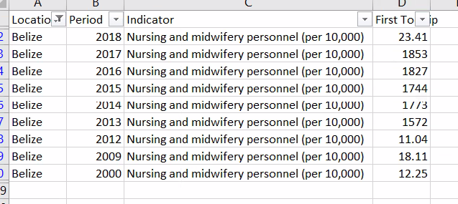
Data Exploration/Cleansing

Slide 8
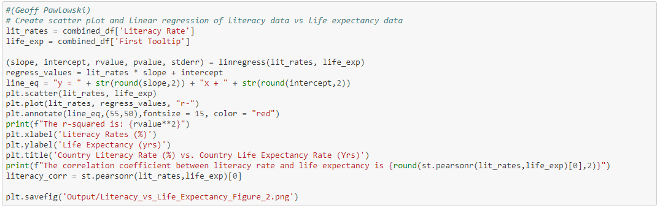
Data Analysis
Scatter Plots – Societal Indicator vs Life Expectancy
Run linear regression
Measure correlation coefficient
Visually inspect to determine if any non-linear relationships may be occurring

Slide 9
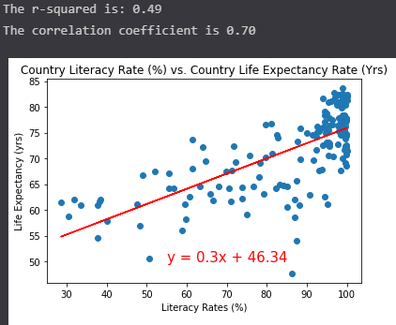
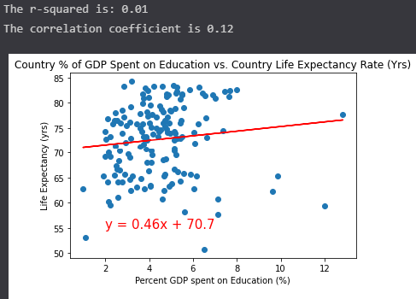
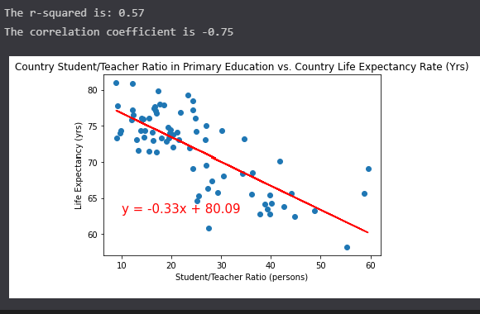
How will the life expectancy be impacted by education parameter?

Slide 10
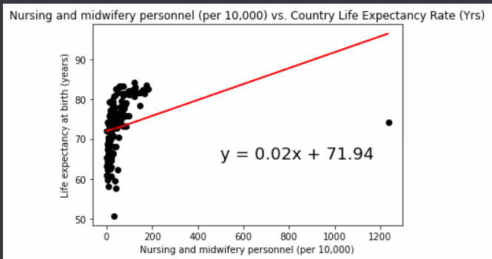
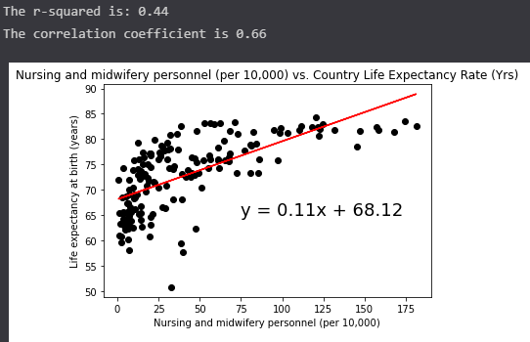
How will the life expectancy be impacted by healthcare parameter?
Remember our outlier data from before….?

Slide 11
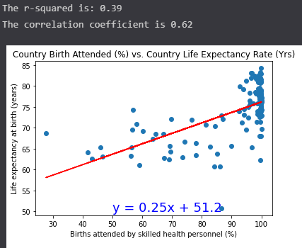
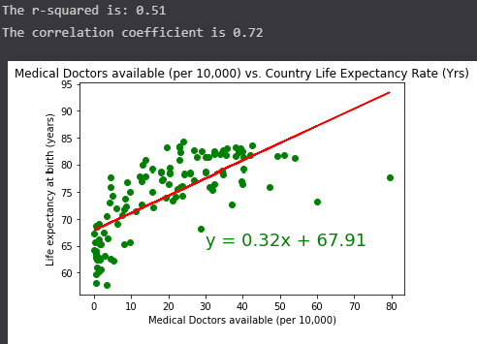
How will the life expectancy be impacted by healthcare parameter?

Slide 12
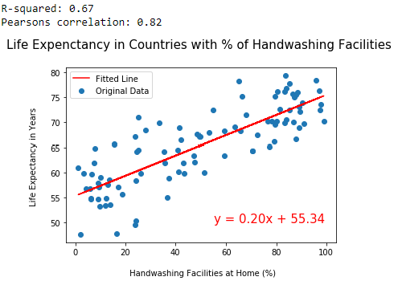
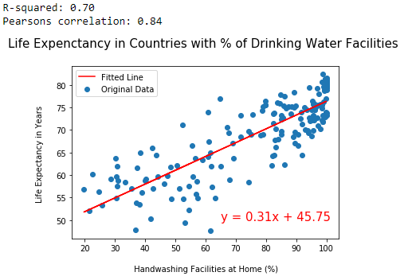
How will the life expectancy be impacted by Basic Infrastructure/Sanitation parameters?

Slide 13
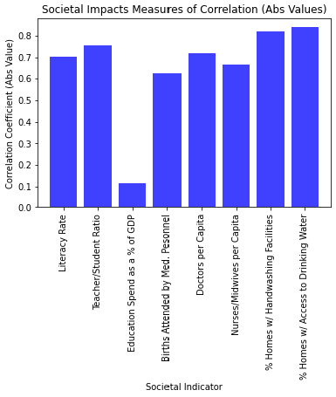
Final Conclusions
All three sub-categories showed strong correlations with life expectancy
Access to basic infrastructure and sanitation sub-group did grade-out best
Education Spending as a % of a countries G-Gross Domestic Product was found to have no correlation to the outcome variable.
High r-squared values for all of these independent variables suggests collinearity and that these societal indicators may rise together as a society advances

